Slide 1
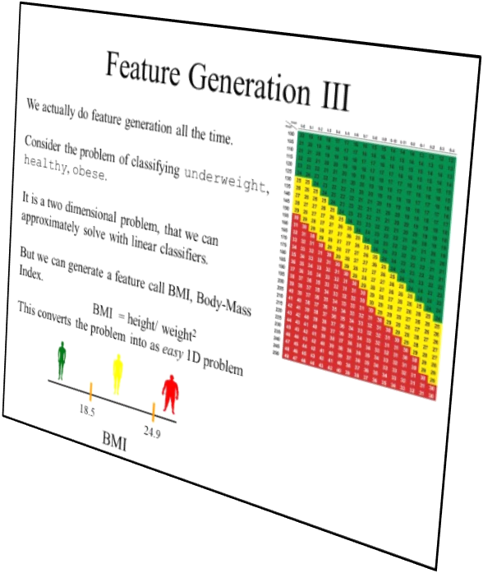
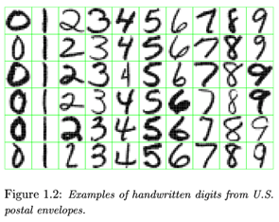
Let us start with a review/preview
Recall this issue of feature generation?
For many problems, this is the key issue.
What if there was a classification algorithm, that could automatically generate higher level features…
1
63

Slide 2
What are connectionist neural networks?
Connectionism refers to a computer modeling approach to computation that is loosely based upon the architecture of the brain.
Connectionist approaches are very old (1950’s), but is recent years (under the name Deep Learning) they have become very competitive, due to:
    Increases in computational power
    Availability of lots of data
    Algorithmic insights

Slide 3
Neural Network History
History traces back to the 50’s but became popular in the 80’s with work by Rumelhart, Hinton, and Mclelland
  A General Framework for Parallel Distributed Processing in Parallel Distributed Processing: Explorations in the Microstructure of Cognition
Peaked in the 90’s, died down, now peaking again:
  Hundreds of variants
  Less a model of the actual brain than a useful tool, but still some debate
Numerous applications
  Handwriting, face, speech recognition
  Vehicles that drive themselves
  Models of reading, sentence production, dreaming
Debate for philosophers and cognitive scientists
  Can human consciousness or cognitive abilities be explained by a connectionist model or does it require the manipulation of symbols?

Slide 4
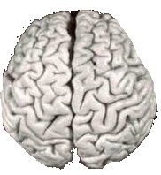
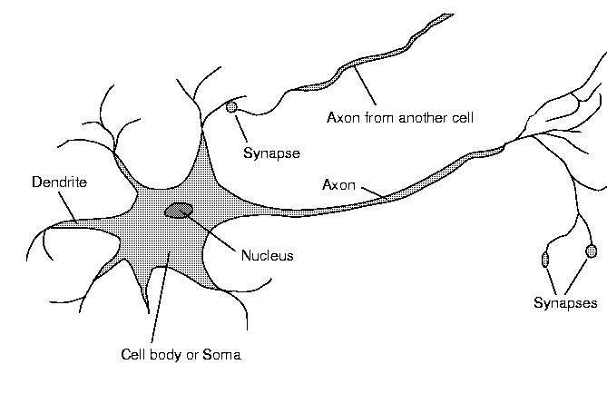
Although heterogeneous, at a low level the brain is composed of neurons
  A neuron receives input from other neurons (generally thousands) from its synapses
  Inputs are approximately summed
  When the input exceeds a threshold the neuron sends an electrical spike that travels that travels from the body, down the axon, to the next neuron(s)
The point at which neurons join other neurons is called a synapse
Notes:
Based on biology NN: basic theory
In fact: still don’t know exactly how our brain work – but we do know certain things about it, what certain parts of the brain do
Tree: Dendrite: receive info from connections;

Slide 5
Neural Networks
We are born with about 100 to 200 billion neurons
A neuron may connect to as many as 100,000 other neurons
Many neurons die as we progress through life
We continue to learn
Notes:
http://www.youtube.com/watch?v=sQKma9uMCFk
http://www.youtube.com/watch?v=NjgBnx1jVIU&feature=related
http://www.youtube.com/watch?v=T6NhLfZuYIg&feature=related
http://www.youtube.com/watch?v=-CrJI4BwRQc&NR=1&feature=fvwp

Slide 6
From a computational point of view, the fundamental processing unit of a brain is a neuron
Moreover, neurons are also the brains unit of memory.
This must be true, since there is really nothing else in the brain.
Notes:
NNs are built based a large number of neurons – first need to know how each neuron work

Slide 7
Simplified model of computation
Imagine you have a neuron that has many input dendrites that receive a signal from your cones (cones are the photo receptors in your eye that are sensitive to light intensity).
If only a few send a signal, there is no activation.
When many send a signal, the neuron sends an electrical spike that travels to a muscle, that closes the eyes.
However, note that while some dendrites do receive data from the eyes, ears, nose, heat/pressure from skin etc, and some axons do send signals to muscles. 99.999% of neurons just communicate with other neurons. The story above is too simple, there will be many layers of neurons involved in even blinking
Notes:
Firing patterns: weights (strength) of input adjusted – learning
long-term changes in the strengths of the connections can be formed depending on the firing patterns of other neurons - thought to be the basis for learning in our brains.
http://www.youtube.com/watch?v=T6NhLfZuYIg&feature=related
http://www.youtube.com/watch?v=VNNsN9IJkws&feature=related

Slide 8

Comparison of Brains and Traditional Computers
200 billion neurons, 32 trillion synapses
Element size: 10⁻⁶ m
Energy use: 25W
Processing speed: 100 Hz
Parallel, Distributed
Fault Tolerant
Learns: Yes
Intelligent/Conscious: Usually
Several billion bytes RAM but trillions of bytes on disk
Element size: 10⁻⁹ m
Energy watt: 30-90W (CPU)
Processing speed: 10⁹ Hz
Serial, Centralized
Generally not Fault Tolerant
Learns: Some
Intelligent/Conscious: Generally No

Slide 9
The First Neural Networks
McCulloch and Pitts produced the first neural network in 1943
Their goal was not classification/AI, but to understand the human brain
Many of the principles can still be seen in neural networks of today
Notes:
Not yet powerful: only a single neuron, fixed weights – but is the basic idea extended later to develop powerful ANN

Slide 10
The First Neural Networks
Consisted of:
A set of inputs - (dendrites)
A set of resistances/weights – (synapses)
A processing element - (neuron)
A single output - (axon)
X₁
2
2
X₂
Y
-1
X₃
Notes:
Brain learn by adjusting synapses (resistances/weights) – to form long term learning
Any questions?

Slide 11
X₁
2
X₂
2
Y
-1
X₃
The activation of a neuron is binary. That is, the neuron either fires (activation of one) or does not fire (activation of zero).
Notes:
An example of the first NN based on the math model:

Slide 12
X₁
X₁
2
2
2
X₂
2
X₂
Y
Y
-1
-1
X₃
X₃
For the network shown here the activation function for unit Y is:
f(y_in) = 1, if y_in >= θ;
else f(y_in) = 0
where y_in is sum of the total input signal received;
θ is the threshold for Y
Notes:
theta

Slide 13
X₁
2
X₂
2
Y
-1
X₃
Neurons in a McCulloch-Pitts network are connected by directed, weighted paths
Notes:
Weights are fixed
Later learning algorithms were developed: ANN has the ability of learn starting from initial weights

Slide 14
X₁
2
X₂
2
Y
-1
X₃
If the weight on a path is positive the path is excitatory, otherwise it is inhibitory
  x₁ and x₂ encourage the neuron to fire
  x₃ prevents the neuron from firing
Notes:
X3 = 1, reduce the sum of input, prevent the neuron from firing
X2 = 1, increase the sum of the input, encourage the neuron to fire

Slide 15
X₁
2
X₂
2
Y
-1
X₃
Each neuron has a fixed threshold. If the total input into the neuron is greater than or equal to the threshold, the neuron fires
Notes:
Threshold: important idea in M-P NNs

Slide 16
X₁
2
X₂
2
Y
-1
X₃
It takes one time step for a signal to pass over one connection. One clock cycle.
Notes:
Multi-layer NN: a chain of actions through the NN

Slide 17
The First Neural Networks
Using McCulloch-Pitts model we can model logic functions
Let’s look at some examples

Slide 18
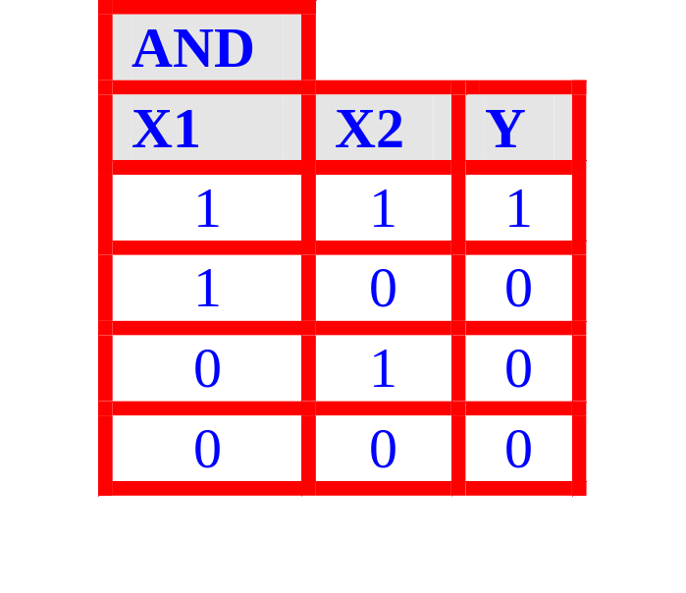
The AND Function
If (X₁ * 1) + (X₂ * 1) ≥ Threshold(Y)
Output 1
Else Output 0
X₁
1
Y
X₂
1
AND Function
Threshold(Y) = 2
Notes:
Set the weights and the threshold at the right level
Also: more than one possible set of NN with weights and threshold can fulfil the same function

Slide 19
The AND Function
Case 1
If (1 * 1) + (1 * 1) ≥ 2
Output 1
Else Output 0
1
1
Y
1
1
1
AND Function
Threshold(Y) = 2
Notes:
Set the weights and the threshold at the right level
Also: more than one possible set of NN with weights and threshold can fulfil the same function

Slide 20
The AND Function
Case 2
If (1 * 1) + (0 * 1) ≥ 2
Output 1
Else Output 0
1
1
Y
0
0
1
AND Function
Threshold(Y) = 2
Notes:
Set the weights and the threshold at the right level
Also: more than one possible set of NN with weights and threshold can fulfil the same function

Slide 21
The AND Function
Case 3
If (0 * 1) + (1 * 1) ≥ 2
Output 1
Else Output 0
0
1
Y
0
1
1
AND Function
Threshold(Y) = 2
Notes:
Set the weights and the threshold at the right level
Also: more than one possible set of NN with weights and threshold can fulfil the same function

Slide 22
The AND Function
Case 4
If (0 * 1) + (0 * 1) ≥ 2
Output 1
Else Output 0
0
1
Y
0
0
1
AND Function
Threshold(Y) = 2
Notes:
Set the weights and the threshold at the right level
Also: more than one possible set of NN with weights and threshold can fulfil the same function

Slide 23
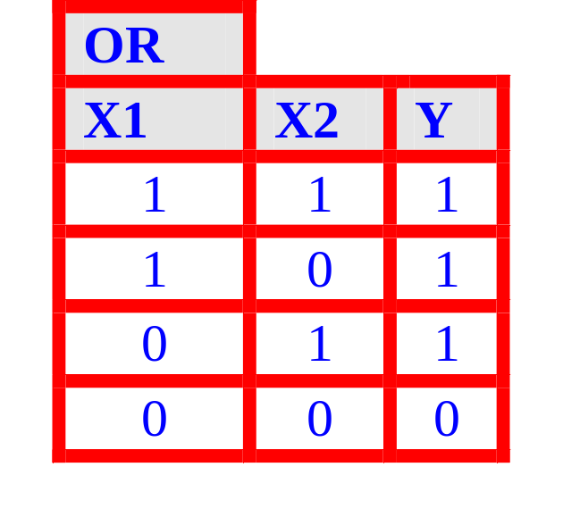
The OR Function
If (X₁ * 2) + (X₂ * 2) ≥ Threshold(Y)
Output 1
Else Output 0
X₁
2
Y
X₂
2
OR Function
Threshold(Y) = 2

Slide 24
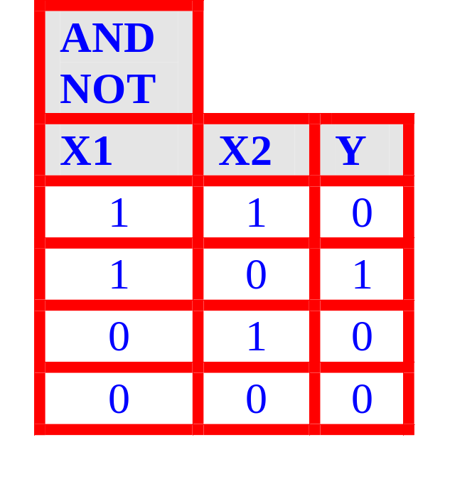
The AND NOT Function
An AND-NOT function calculates A ∧ ¬B
If (X₁ * 2) + (X₂ * -1) ≥ Threshold(Y)
Output 1
Else Output 0
X₁
2
Y
X₂
-1
AND NOT Function
Threshold(Y) = 2

Slide 25
Expressiveness of the McCulloch-Pitts Network
Our success with AND, OR and AND-NOT might lead us to think that we can model any logic function with McCulloch-Pitts Networks.
What weights/threshold could we use for XOR?
It is easy to see that this is not possible!
However, there is a trick if we combine several neurons in layers..
X₁
?
Y
X₂
?
XOR Function

Slide 26
We know that we can write XOR as a disjunction of AND-NOTs
X₁ XOR X₂ = (X₁ AND NOT X₂) OR (X₂ AND NOT X₁)
So we can make a XOR from these atomic parts….
XOR
X1
X2
Y
1
1
0
X₁
-1
1
0
1
0
1
1
Y
0
0
0
X₂
Z₂
2
2
X₁ XOR X₂ = (X₁ AND NOT X₂) OR (X₂ AND NOT X₁)
Notes:
First layer

Slide 27
XOR
2
X1
X2
Y
2
1
1
0
X₁
Z₁
1
0
1
0
1
1
Y
0
0
0
X₂
-1
X₁ XOR X₂ = (X₁ AND NOT X₂) OR (X₂ AND NOT X₁)
Notes:
First layer

Slide 28
XOR
X1
X2
Y
2
1
1
0
Z₁
1
0
1
0
1
1
Y
0
0
0
Z₂
2
X₁ XOR X₂ = (X₁ AND NOT X₂) OR (X₂ AND NOT X₁)
Notes:
Second layer

Slide 29
The XOR Function
XOR
X1
X2
Y
2
1
1
0
2
1
0
1
X₁
-1
Z₁
0
1
1
Y
0
0
0
X₂
-1
Z₂
2
2
XOR Function
X₁ XOR X₂ = (X₁ AND NOT X₂) OR (X₂ AND NOT X₁)
Notes:
Difficult: non-linear saperable
Actually not possible to implement by using a simple neuron – explained in depth later when learned more
Multi-layer NN: actually the combination of two neurons Z1 and Z2

Slide 30
What else can neural nets represent?
With a single layer, by carefully setting the weights and the threshold, you can represent any linear function. Note the inputs are real numbers.
X₁
B
10
Y
9
X₂
8
A
7
Linear Function
6
5
4
3
2
1
1
2
3
4
5
6
7
8
9
10

Slide 31
What else can neural nets represent?
With a multiple layers, by carefully setting the weights and the threshold, you can represent any arbitrary function!
10
X₁
B
9
Y
8
X₂
A
7
6
X₃
C
X₇
G
Y
Y
5
4
X₄
D
X₈
H
3
2
X₅
E
Y
1
X₆
F
Arbitrary Functions
1
2
3
4
5
6
7
8
9
10

Slide 32
What else can neural nets represent?
With a multiple layers, by carefully setting the weights and the threshold, you can represent any arbitrary function.
Stop! Just because you can represent any function, does not mean you can learn any function.
10
X₁
B
9
Y
8
X₂
A
7
6
X₃
C
X₇
G
Y
Y
5
4
X₄
D
X₈
H
3
2
X₅
E
Y
1
X₆
F
Arbitrary Functions
1
2
3
4
5
6
7
8
9
10

Slide 33

Stop! Just because you can represent any function, does not mean you can learn any function.
We make do simple logic functions, and linear classifiers by hand.
But suppose I want the input to be a 1,000 by 1,200 image, and the output to be 1|0 (cat|dog)
Then there are 1,200,000 inputs for the (B/W) image. Even if the weights are binary (and they are not), then there are 2¹²⁰⁰⁰⁰⁰ possibilities.
Our only hope is somehow learn the weights.
X₁
B
Y
X₂
A
X₃
C
X₇
G
(cat)
(dog)
Y
Y
X₄
D
X₈
H

Slide 34
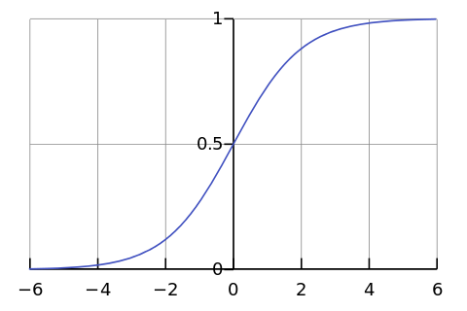

First, some generalizations..
  We allow the inputs to be arbitrary real numbers
  We allow the weights to be arbitrary real numbers
  We allow the thresholds to be arbitrary real numbers
The first two means that the output could be very large (positive or negative)
However, we prefer the output to be bounded between 0 or 1 (or sometimes, -1 to 1), so we can use a sigmoid (or similar) function to “squash” the function into the desired range.
X₁
A
X₂
B
Y
X₃
C
-23.4
-1.2

Slide 35
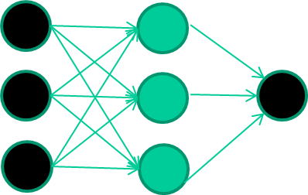
Learning a Neural Network with BackPropagation
A dataset
Features class
1.4 2.7 1.9 0
3.8 3.4 3.2 0
6.4 2.8 1.7 1
4.1 0.1 0.2 0
etc …

Slide 36
Training the neural network
Features class
1.4 2.7 1.9 0
3.8 3.4 3.2 0
6.4 2.8 1.7 1
4.1 0.1 0.2 0
etc …

Slide 37
Training data
Features class
1.4 2.7 1.9 0
3.8 3.4 3.2 0
6.4 2.8 1.7 1
4.1 0.1 0.2 0
etc …
Initialise with random weights

Slide 38
Training data
Features class
1.4 2.7 1.9 0
3.8 3.4 3.2 0
6.4 2.8 1.7 1
4.1 0.1 0.2 0
etc …
Present a training pattern
1.4
2.7
1.9

Slide 39
Training data
Features class
1.4 2.7 1.9 0
3.8 3.4 3.2 0
6.4 2.8 1.7 1
4.1 0.1 0.2 0
etc …
Feed it through to get output
1.4
2.7 0.8
1.9

Slide 40
Training data
Features class
1.4 2.7 1.9 0
3.8 3.4 3.2 0
6.4 2.8 1.7 1
4.1 0.1 0.2 0
etc …
Compare with target output
1.4
2.7 0.8
0
1.9 error 0.8

Slide 41


Training data
Features class
1.4 2.7 1.9 0
3.8 3.4 3.2 0
6.4 2.8 1.7 1
4.1 0.1 0.2 0
etc …
Adjust weights based on error
1.4
2.7 0.8
0
1.9 error 0.8

Slide 42
Training data
Features class
1.4 2.7 1.9 0
3.8 3.4 3.2 0
6.4 2.8 1.7 1
4.1 0.1 0.2 0
etc …
Present a training pattern
6.4
2.8
1.7

Slide 43
Training data
Features class
1.4 2.7 1.9 0
3.8 3.4 3.2 0
6.4 2.8 1.7 1
4.1 0.1 0.2 0
etc …
Feed it through to get output
6.4
2.8 0.9
1.7

Slide 44
Training data
Features class
1.4 2.7 1.9 0
3.8 3.4 3.2 0
6.4 2.8 1.7 1
4.1 0.1 0.2 0
etc …
Compare with target output
6.4
2.8 0.9
1
1.7 error -0.1

Slide 45
Training data
Features class
1.4 2.7 1.9 0
3.8 3.4 3.2 0
6.4 2.8 1.7 1
4.1 0.1 0.2 0
etc …
Adjust weights based on error
6.4
2.8 0.9
1
1.7 error -0.1

Slide 46
Training data
Features class
1.4 2.7 1.9 0
3.8 3.4 3.2 0
6.4 2.8 1.7 1
4.1 0.1 0.2 0
etc …
And so on ….
6.4
2.8 0.9
1
1.7 error -0.1
Repeat this thousands, maybe millions of times – each time
taking a random training instance, and making slight
weight adjustments
Algorithms for weight adjustment are designed to make
changes that will reduce the error

Slide 47
The decision boundary perspective…
Initial random weights

Slide 48
The decision boundary perspective…
Present a training instance / adjust the weights

Slide 49
The decision boundary perspective…
Present a training instance / adjust the weights

Slide 50
The decision boundary perspective…
Present a training instance / adjust the weights

Slide 51
The decision boundary perspective…
Present a training instance / adjust the weights

Slide 52
The decision boundary perspective…
Eventually ….

Slide 53
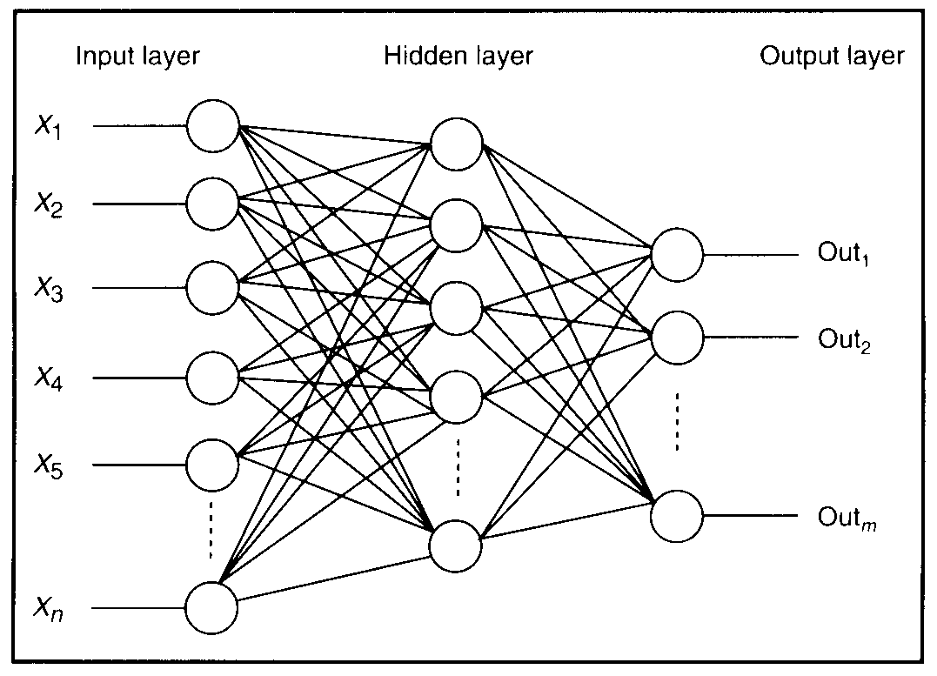

Feature detectors

Slide 54
what is this unit doing?

Slide 55
Hidden layer units become self-organised feature detectors
1 5 10 15 20 25 …
…
1
strong positive weight
low/zero weight
63

Slide 56
What does this unit detect?
1 5 10 15 20 25 …
…
1
strong positive weight
low/zero weight
63

Slide 57
What does this unit detect?
1 5 10 15 20 25 …
…
1
strong positive weight
low/zero weight
it will send strong signal for a horizontal
line in the top row, ignoring everywhere else
63

Slide 58
What does this unit detect?
1 5 10 15 20 25 …
…
1
strong positive weight
low/zero weight
63

Slide 59
What does this unit detect?
1 5 10 15 20 25 …
…
1
strong positive weight
low/zero weight
Strong signal for a dark area in the top left
corner
63

Slide 60
What features might you expect a good NN
to learn, when trained with data like this?

Slide 61
vertical lines
1

Slide 62
Horizontal lines

Slide 63
Small circles

Slide 64
Small circles
1
But what about position invariance ???
our example unit detectors were tied to
specific parts of the image
63

Slide 65
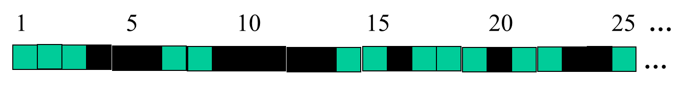
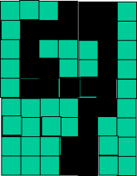
successive layers can learn higher-level features …
detect lines in
Specific positions
etc …
Higher level detetors
( horizontal line,
“RHS vertical lune”
“upper loop”, etc…
etc …
v

Slide 66
successive layers can learn higher-level features …
detect lines in
Specific positions
etc …
Higher level detetors
( horizontal line,
“RHS vertical lune”
“upper loop”, etc…
etc …
v
What does this unit detect?

Slide 67
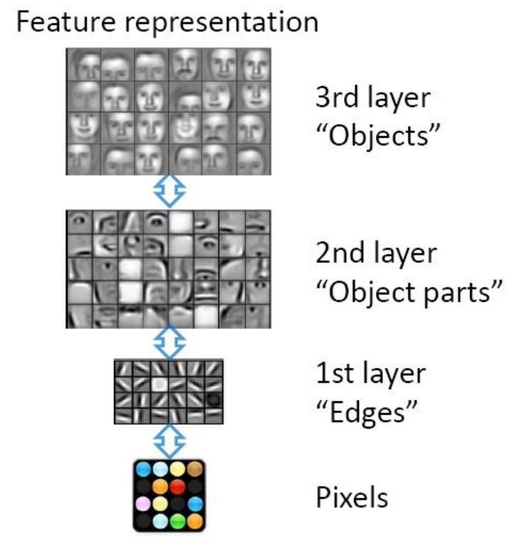

Slide 68
So: multiple layers make sense

Slide 69
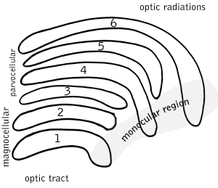
So: multiple layers make sense
Your brain works that way

Slide 70
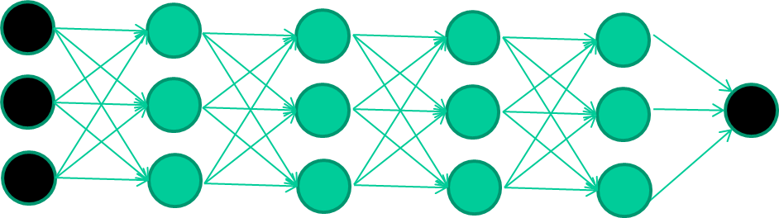
So: multiple layers make sense
Many-layer neural network architectures should be capable of learning the true underlying features and ‘feature logic’, and therefore generalise very well …

Slide 71
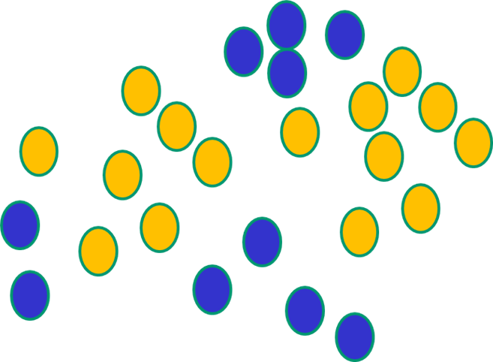

But, until very recently, weight-learning algorithms simply did not work on multi-layer architectures

Slide 72
Along came deep learning …

Slide 73
The new way to train multi-layer NNs…

Slide 74
The new way to train multi-layer NNs…
Train this layer first

Slide 75
The new way to train multi-layer NNs…
Train this layer first
then this layer

Slide 76
The new way to train multi-layer NNs…
Train this layer first
then this layer
then this layer

Slide 77
The new way to train multi-layer NNs…
Train this layer first
then this layer
then this layer
then this layer

Slide 78
The new way to train multi-layer NNs…
Train this layer first
then this layer
then this layer
then this layer
finally this layer

Slide 79
The new way to train multi-layer NNs…
EACH of the (non-output) layers is trained to be an auto-encoder
Basically, it is forced to learn good features that describe what comes from the previous layer

Slide 80
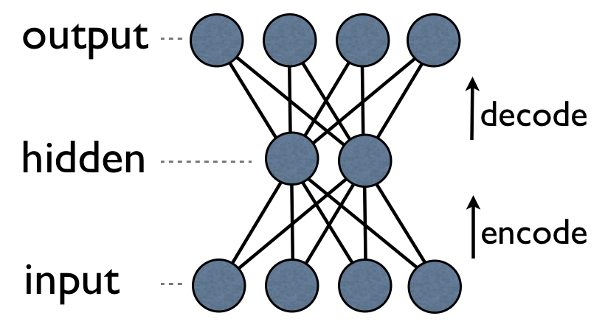
an auto-encoder is trained, with an absolutely standard weight-adjustment algorithm to reproduce the input

Slide 81
an auto-encoder is trained, with an absolutely standard weight-adjustment algorithm to reproduce the input
By making this happen with (many) fewer units than the inputs, this forces the ‘hidden layer’ units to become good feature detectors

Slide 82
intermediate layers are each trained to be auto encoders (or similar)

Slide 83
Final layer trained to predict class based on outputs from previous layers

Slide 84
Which of the “Pigeon Problems” can be solved by Deep Learning?
With enough data…
10
9
8
7
6
Very Good
Very Good
Very Good
5
4
3
2
1
1
2
3
4
5
6
7
8
9
10
100
10
90
9
80
8
70
7
60
6
50
5
40
4
30
3
20
2
10
1
10
20
30
40
50
60
70
80
90
100
1
2
3
4
5
6
7
8
9
10

Slide 85
Neural Networks: Discussion
Training is slow
Interpretability is hard (but getting better)
Network topology layouts ad hoc
Can be hard to debug
May converge to a local, not global, minimum of error
Not known how to model higher-level cognitive mechanisms

